Slide 1

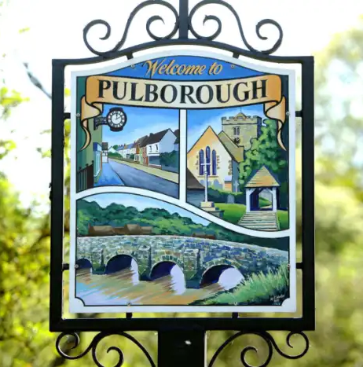
Pulborough Parish Neighbourhood Wardens
2018 – 2019 overview
Vanessa Green & Carol Boniface
Notes:
Good evening everyone, this presentation will show some of the work that we have achieved over the past year to date. It consists of a couple of case studies and the data used is from the period of Jan 2018 – Jan 2019 and is taken from our daily records.
We are starting with a case study about ASB issues that was happening here in Pulborough last year and how with working with other agencies we helped to tackle the problems.

Slide 2
Case study – Anti-social behaviour
We started to receive calls of low level ASB from January 2018 onwards.
Examples of the calls received:
Newspaper arson in woodland
Smoking in a bin cupboard
Climbing on scaffolding
Groups gathering/verbally abusive to residents
Door knocking
Smoking, drinking and littering
Broken light posts alongside the railway
Smoking and loitering on private property
Criminal damage to fence in pocket park
Smoking at youth club
Graffiti on playground equipment and Bus stops
Five young people were placed on Acceptable behaviour contracts – Six month contracts with conditions agreed by Parents, young people and Wardens.
Weekly/fortnightly sessions held to address behaviour/identify support needed.
Notes:
Vanessa – to read out the above and expand if necessary.

Slide 3
How we tackle ASB:
We respond to the reports and give reassurance and crime prevention advice.
We advise that the crime must be reported via 101 or 999 at the time it is happening.
We patrol at keys times and locations to deter and disrupt behaviours.
Warning/awareness letters sent to homes of young people.
We have placed CCTV equipment in locations to deter and gather evidence.
We instruct empty property owners to secure the site.
We put up ASB related notices in Hotspot areas.
We gather intelligence and pass onto the appropriate agency e.g. Police, Housing authority, HDC Anti-social behaviour caseworker.
We have powers to enforce via HDC Community safety team: PSPO’s, CPN’s, injunctions and fixed penalty notices/warning notices.
Notes:
Carol – To read out the above and expand if necessary.

Slide 4
Throughout the year the ASB continued and escalated in seriousness.
An urgent multi - agency meeting was arranged to gather information, share intelligence and take action.
On 10th December 2018 we met with Professionals from the Police, HDC Community Safety team, ASB Caseworker, Housing Managers and Secondary School Head of House.
As a result of this meeting the Police launched Operation Alarm.
Op Alarm began at the beginning of January 2019 with increased Police patrols in Pulborough and young people in hotpot areas being stopped/spoken to and searched.
In November and December 2018 there were 33 ASB related calls to the Police (20 in November and 13 in December).
In January 2019 there were 4 calls received to the police and the reports of ASB have continued to decrease.
Notes:
Vanessa

Slide 5
Notes:
Carol – These are some of the topics that we get involved with. Expand a little on each one.

Slide 6
Notes:
Vanessa – Read out above. Expand and point out the Parish remit to help prevent isolations in older people and to link them up with local services.

Slide 7
Notes:
Carol – mention that the expected trend is for ASB to rise in the school holidays and these figures show that isn’t always the case.

Slide 8
Case Study 2018
Complaints from residents about poor parking around school during morning and afternoon
We suggested a walking bus scheme to alleviate the parking
Engaged with parents/guardians at parents evening
Set up walking bus with support from PSSC, PC, PTA and school
Up to 30 children attend which is nearly 10% of the school
Noted improvement of parking issues during key times
Continue to monitor the area with warning notices given when necessary
Parking enforcement teams have issued a couple of fixed penalty notices
Improves general health and wellbeing
Notes:
Vanessa - Read the above

Slide 9
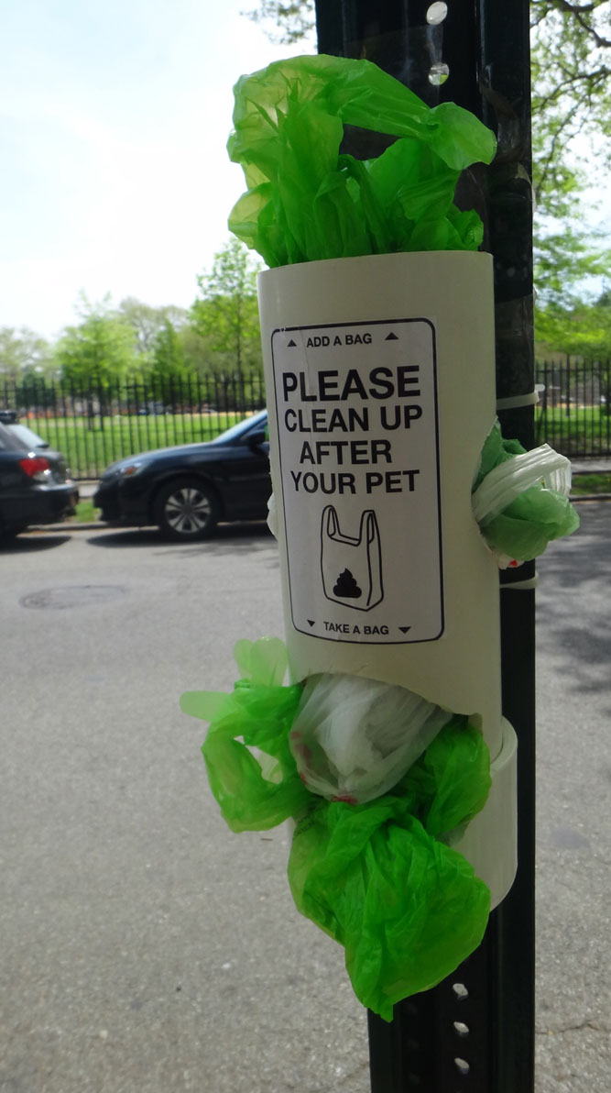
Case Study 2018
The walking bus scheme has led onto a new joint initiative
Staff and Volunteers noted how much dog fouling was seen on their route
Some of the school children stepped in the dog mess on their walk into school
The school eco council are launching a project to provide dog waste bags in recycled plastic bottles
We have designed and produced posters to help tackle the problem
A local resident dog behaviourist has offered to supply the dog waste bags
Because until this happens……..
Notes:
Carol - Read out above notes – example picture for dog waste bags

Slide 10

Humans are responsible!

Slide 11
Feedback Quotes
“Thank you for putting the sports sessions on during the school holidays.”
“Dear Vanessa and Carol.
Thank you both for your efforts in tracking down the bike which was stolen from my garage at the weekend. It was a classic case of the community being able to have a central contact for these kind of incidents and with your local knowledge and contacts proved we have a viable method of dealing with antisocial behaviour.”
“This is just a quick note to say what a wonderful job the Neighbourhood Wardens are doing.
About 3 weeks ago I needed their help/advice as an elderly neighbour of mine had locked herself out.”
“The Wardens are such an asset to the village.”
“They were both so helpful, kind and genuine.”
Notes:
Carol

Slide 12
Project achievements
April 2018 started the walking bus to alleviate parking at the school
April 2019 dog fouling project with St. Marys School
Held 14 free sports sessions with HDC sports development team during school holidays – with increased numbers and up to 25 young people attending
Due to the popularity of the Shoretrax bike sessions we have British cycling and King Ramps interested in supporting community projects with funding opportunities
Following the Pocket Park clear up days a team of volunteers meet up monthly to litter pick in Pulborough
£480.00 was obtained from the Police property act fund to bring Immersicare virtual reality sessions to local clubs
£170.00 of funding from ACTS 435 to help vulnerable families
In the pipeline:
PPF - Pulborough Pen Friends project – School children to write to Elderly residents in local Care homes
Coffee and chat sessions for Ex Veterans
Notes:
To summarise: I hope that we have managed to highlight the variety of work that we get involved with and that the scheme is continuing to grow in strength. Remember we are here as a point of contact for the residents of Pulborough Parish to support and advise, if we’re unable to help then we’ll put in touch with those who can. Thank you for listening.

Slide 13

Any questions?

Slide 14
